Slide 1

ABC Call Volume Trend Analysis

Slide 2
PROJECT DESCRIPTION
Project: Optimizing Inbound Customer Support
Objective: Analyze customer experience data to enhance customer satisfaction and operational efficiency.
Data: Dataset spanning 23 days, including agent details, queue times, call times, durations, and statuses.
Key Roles:
CX Team: Analyzes feedback, derives insights, and disseminates information.
Customer Service Representatives: Handle inbound calls, providing support.
AI-Powered Tools:
IVR: Automates initial interactions.
RPA: Automates repetitive tasks.
Predictive Analytics: Anticipates customer needs.
Intelligent Routing: Directs calls to appropriate agents.
Project Scope:
Analyze call metrics, agent performance, and customer satisfaction.
Identify process bottlenecks and inefficiencies.
Develop targeted agent training programs.
Explore AI-powered tool implementation to improve customer experience.
Goal: Optimize inbound customer support operations, increase satisfaction, and drive business growth.

Slide 3
PROJECT APPROACH
Optimize advertising strategies by analyzing call volume trends.
Key Areas of Focus:
Channel Effectiveness: Evaluate the performance of different advertising channels.
Target Audience Identification: Understand the specific audience segments reached by each channel.
Conversion Rates: Analyze which channels drive the most qualified leads.
Cost-Effectiveness: Determine the cost per acquisition (CPA) for each channel.
Data Analysis Techniques:
Time Series Analysis: Analyze call volume trends over time.
Correlation Analysis: Examine the relationship between advertising spend and call volume.
Customer Segmentation: Identify different customer segments.
Attribution Modeling: Determine the impact of specific advertising channels on call volume.
By effectively analyzing call volume data, businesses can optimize their advertising strategies, allocate resources more efficiently, and maximize return on investment.

Slide 4
TECH STACK USED
I have used MS Office LTSC Professional Plus 2021 version for my project -
MS Excel:
Numerical Data: Storing and manipulating numbers, performing calculations using formulas and functions, and creating financial models.
Data Tables and Charts: Organizing large datasets into rows and columns, and generating various charts and graphs to visually represent trends and patterns.
Data Analysis Tools: Offering features like pivot tables for summarizing data, sorting and filtering for focused analysis, and conditional formatting for highlighting important information.
MS PowerPoint:
Slide Creation: Build compelling presentations using a variety of layouts for text, images, charts, and graphs.
Visual Storytelling: Enhance your message with multimedia elements like pictures, videos, and sound effects, bringing your presentation to life.
Customization: Tailor your presentation to your audience and brand with a wide range of design themes, fonts, and color schemes.
Delivery Tools: Projector support, presenter notes, and speaker view with a countdown timer empower you to deliver a confident and engaging presentation.

Slide 5
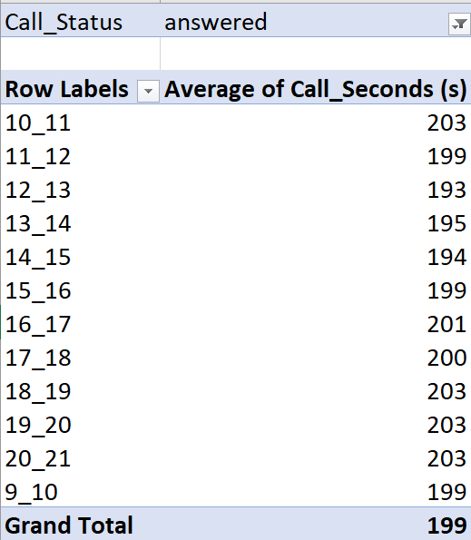
TASKS
Average Call Duration: Determine the average duration of all incoming calls received by agents. This should be calculated for each time bucket.
Task: What is the average duration of calls for each time bucket?

Slide 6
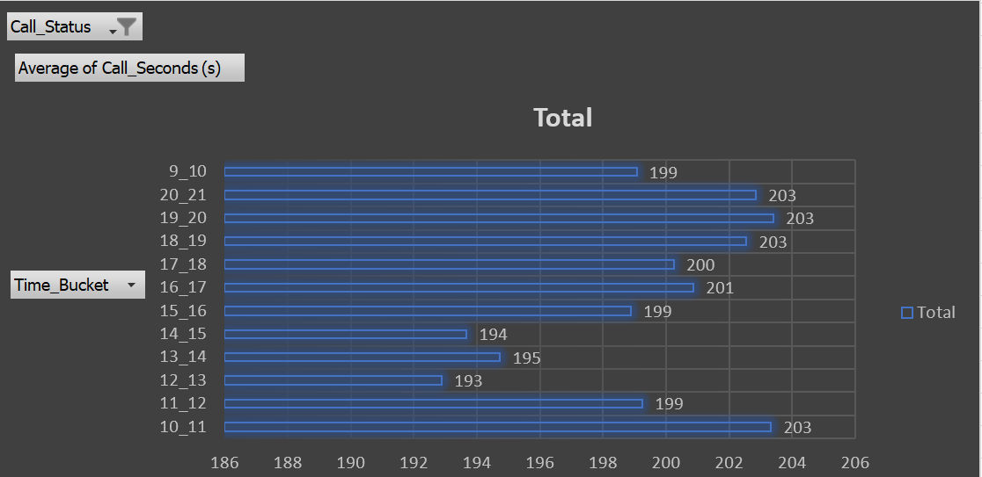
The analysis focused on answered calls, excluding rejected calls to ensure accurate representation of average call duration. This approach avoided skewing the results with irrelevant data points. The analysis revealed consistent call duration patterns across different time buckets, indicating a relatively stable average call handling time.

Slide 7
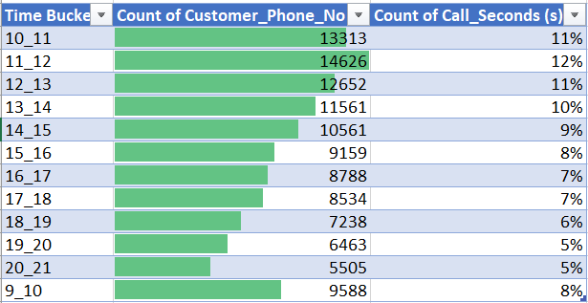
Call Volume Analysis: Visualize the total number of calls received. This should be represented as a graph or chart showing the number of calls against time. Time should be represented in buckets (e.g., 1-2, 2-3, etc.).
Task: Can you create a chart or graph that shows the number of calls received in each time bucket?

Slide 8
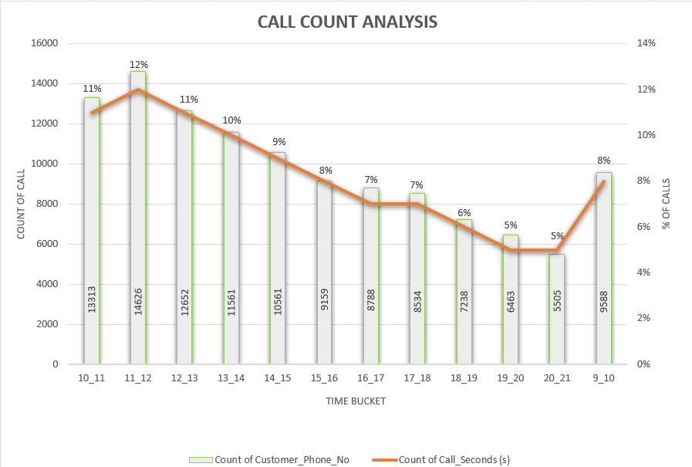
The analysis revealed a distinct pattern in call volume throughout the day. The company experienced a surge in incoming calls during peak hours, specifically between 9 AM and 1 PM. As the day progressed, call volume gradually declined, reaching approximately 5% of the total daily calls by the end of the business day.

Slide 9
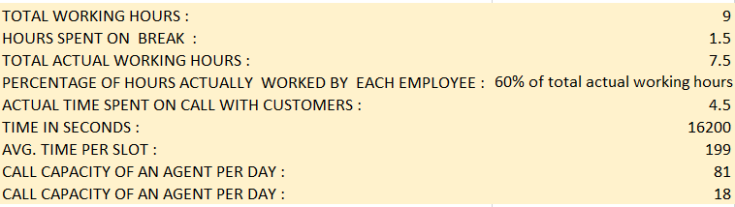
Manpower Planning: The current rate of abandoned calls is approximately 30%. Propose a plan for manpower allocation during each time bucket (from 9 am to 9 pm) to reduce the abandon rate to 10%. In other words, you need to calculate the minimum number of agents required in each time bucket to ensure that at least 90 out of 100 calls are answered.
Task: What is the minimum number of agents required in each time bucket to reduce the abandon rate to 10%?
To determine the optimal number of agents required, the project calculated the average call handling capacity per agent on a daily and hourly basis. Assumptions regarding lunch and snack breaks, along with actual working hours, were provided by Trainity to facilitate accurate calculations. This analysis enabled the assessment of current staffing levels and potential areas for optimization.

Slide 10
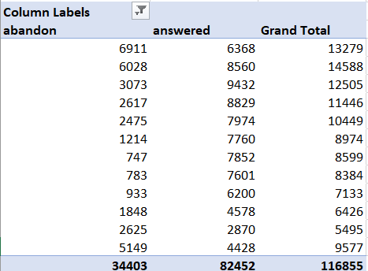
To assess the extent of call abandonment, the number of abandoned and answered calls was calculated. By analyzing this data, the percentage of abandoned calls was determined. The objective was to optimize staffing levels to reduce abandonment rates to a target of 10%.

Slide 11
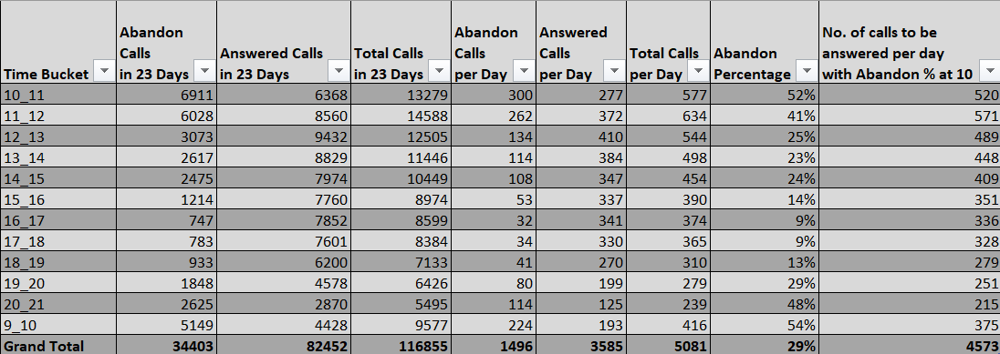

Slide 12
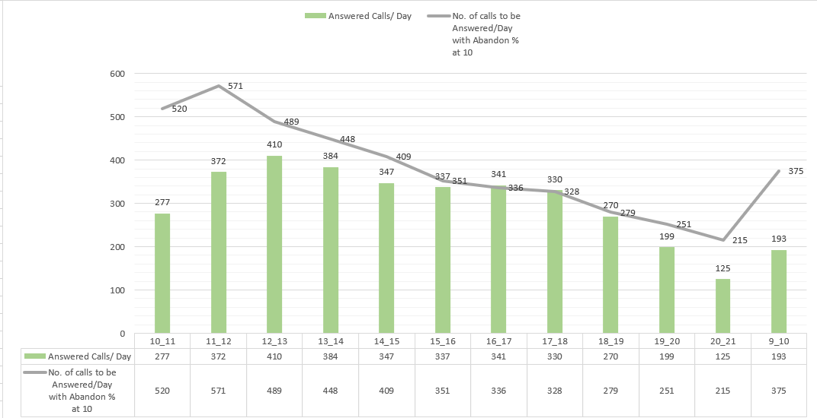
By analyzing daily call volumes and abandonment rates, a target abandonment rate of 10% was established. To achieve this target, the required number of calls to be handled per day was calculated. This analysis enabled the assessment of current staffing levels and the identification of potential areas for optimization to reduce call abandonment rates.

Slide 13
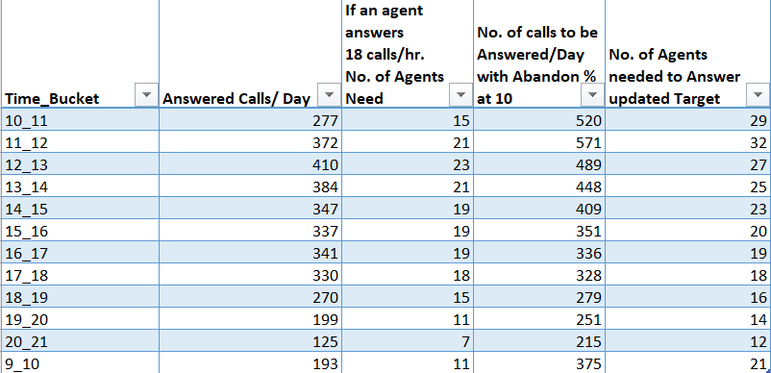

Slide 14
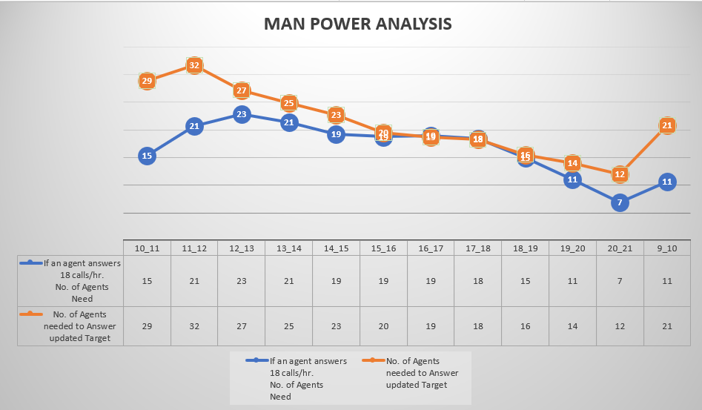
The analysis revealed a significant disparity between current staffing levels and the workforce required to achieve the target abandonment rate. During peak hours, specifically between 9 AM and 2 PM, a substantial increase in staffing is necessary to address the high call volume. The current abandonment rate of approximately 30%, with peaks reaching 50% in certain time slots, underscores the urgent need for additional workforce to ensure adequate customer service and minimize lost business opportunities.

Slide 15
Night Shift Manpower Planning: Customers also call ABC Insurance Company at night but don't get an answer because there are no agents available. This creates a poor customer experience. Assume that for every 100 calls that customers make between 9 am and 9 pm, they also make 30 calls at night between 9 pm and 9 am. The distribution of these 30 calls is as follows: Assumptions: An agent works for 6 days a week; On average, each agent takes 4 unplanned leaves per month; An agent's total working hours are 9 hours, out of which 1.5 hours are spent on lunch and snacks in the office. On average, an agent spends 60% of their total actual working hours (i.e., 60% of 7.5 hours) on calls with customers/users. The total number of days in a month is 30.
Task: Propose a manpower plan for each time bucket throughout the day, keeping the maximum abandon rate at 10%.

Slide 16
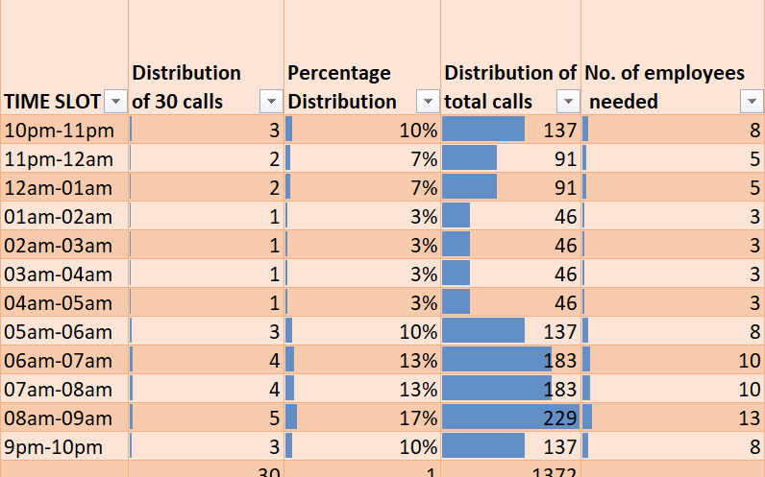

Slide 17
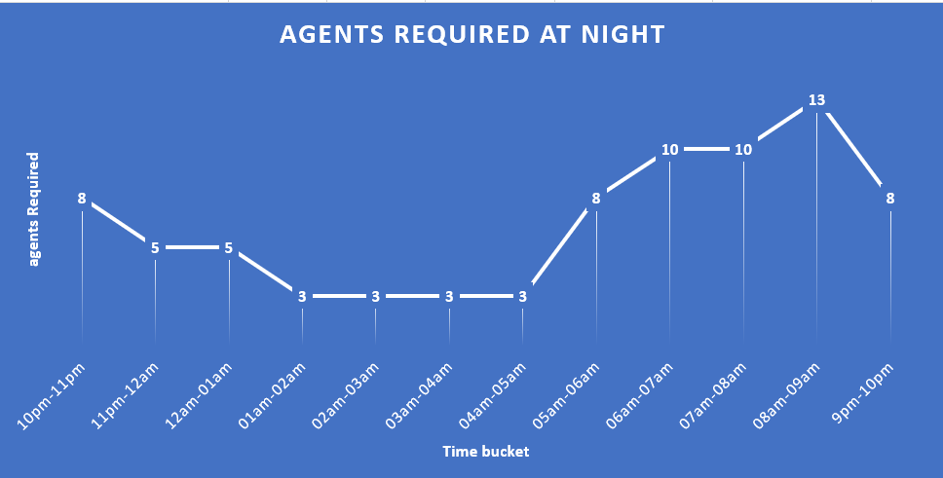
To address the challenge of high call abandonment rates during off-peak hours, the analysis estimated the required number of agents for night shifts. By prorating call volume based on historical data and considering the average call handling time, the project determined the optimal staffing levels to ensure adequate coverage and minimize abandonment. This analysis provides valuable insights for optimizing resource allocation and enhancing customer satisfaction during less busy periods.

Slide 18
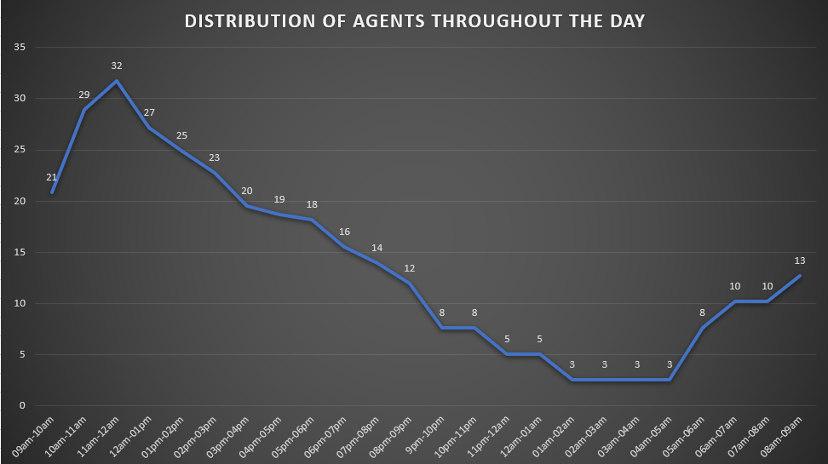
The graph indicates that the number of agents needed remains elevated until midnight and increases again after 6 AM.

Slide 19
INSIGHTS
Peak Call Times: The 18:00-21:00 time bucket consistently receives a higher volume of answered calls, indicating a need for increased staffing during these hours.
High-Volume Time Slot: The 11:00-12:00 time slot experiences the highest overall call volume, totaling 14,626 calls. This highlights the importance of adequate staffing during this period.
Staffing Optimization: To reduce the abandonment rate from 30% to 10%, an additional 57 agents are required. This analysis underscores the need for strategic staffing adjustments to meet peak call volumes and improve customer service.
Night Shift Implementation: Implementing a night shift with 30 agents can enhance call coverage during off-peak hours, further contributing to reduced abandonment rates and improved customer satisfaction.
Overall Impact:
This project has effectively utilized data analysis techniques to identify key trends and patterns within the inbound call data. The insights generated can inform strategic decisions regarding staffing, resource allocation, and operational efficiency. By addressing the identified staffing gaps and optimizing call handling processes, the organization can significantly improve customer satisfaction and overall operational performance.

Slide 20
RESULTS
Completing this project on inbound customer support analytics has been a valuable learning experience. By analyzing call data and understanding the role of CX teams, I gained insights into optimizing customer interactions and improving overall satisfaction. Exploring AI-powered tools has broadened my understanding of modern CX strategies. This project has provided practical experience in analyzing customer data and identifying areas for improvement, equipping me with valuable skills for future CX endeavors.
This project provided valuable insights into data analysis methodologies and their application in real-world scenarios. Key takeaways include:
Data Cleaning and Preparation: Proficiency in handling raw data, including cleaning, organizing, and transforming data for analysis.
Problem Identification: Effective communication with stakeholders to understand project objectives and identify key questions.
Data Analysis Techniques: Mastery of data analysis techniques, including descriptive statistics, data visualization, and SQL querying.
Data-Driven Decision Making: The ability to extract meaningful insights from data and use those insights to inform decision-making processes.
Understanding of Data Analyst Role: A comprehensive understanding of the responsibilities and skills required for a successful data analyst role within an organization.

Slide 21

THANK YOU
Excel File of Analysis

